Slide 1
Relevance Feedback and Query expansion
MODULE 7

Slide 2
Relevance feedback
Relevance feedback is a feature of some information retrieval systems.
The idea behind relevance feedback is to take the results that are initially returned from a given query, to gather user feedback, and to use information about whether or not those results are relevant to perform a new query.
It can usefully distinguish between three types of feedback: explicit feedback, implicit feedback, and blind or "pseudo" feedback.

Slide 3
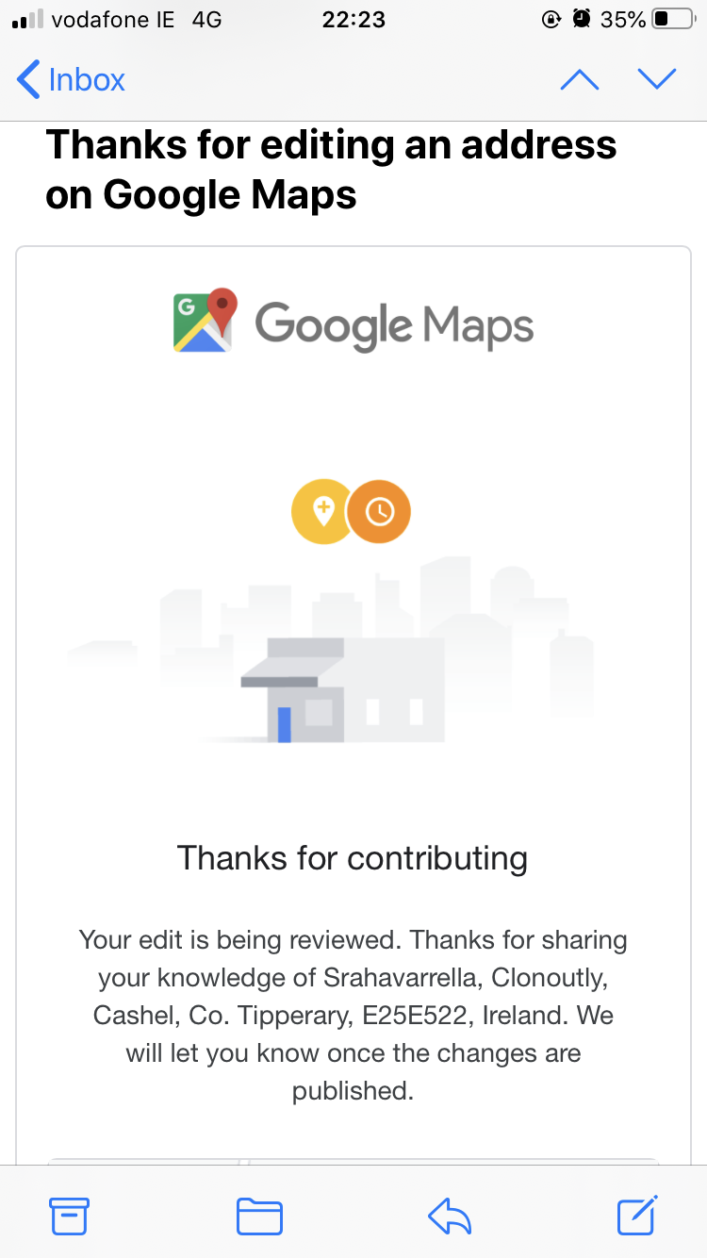
Relevance Feedback
After initial retrieval results are presented, allow the user to provide feedback on the relevance of one or more of the retrieved documents.
Use this feedback information to reformulate the query.
Produce new results based on reformulated query.
Allows more interactive, multi-pass process.

Slide 4
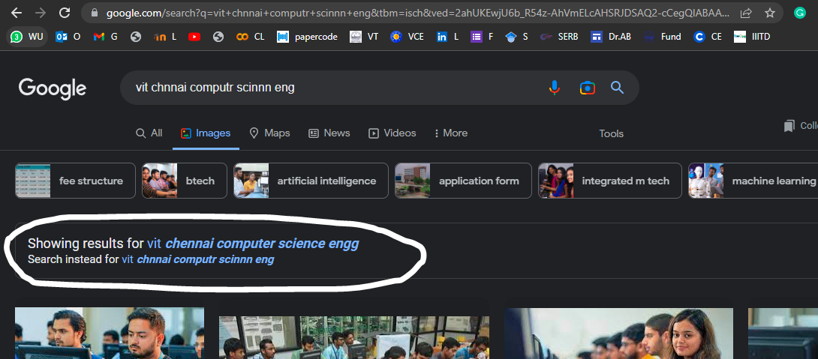


Slide 5


Relevance Feedback Architecture
Document
corpus
Query String
Revised
Query
IR
System
Rankings
ReRanked
Documents
1. Doc2
2. Doc4
3. Doc5
.
.
Query
Reformulation
Ranked
Documents
1. Doc1
2. Doc2
3. Doc3
.
.
1. Doc1 ⇓
2. Doc2 ⇑
3. Doc3 ⇓
.
.
Feedback

Slide 6
Pseudo Feedback Architecture
Document
corpus
Query String
Revised
Query
IR
System
Rankings
ReRanked
Documents
1. Doc2
2. Doc4
3. Doc5
.
.
Query
Reformulation
Ranked
Documents
1. Doc1
2. Doc2
3. Doc3
.
.
Pseudo
Feedback
1. Doc1 ⇑
2. Doc2 ⇑
3. Doc3 ⇑
.
.

Slide 7
Query Reformulation
Revise query to account for feedback:
  Query Expansion: Add new terms to query from relevant documents.
  Term Reweighting: Increase weight of terms in relevant documents and decrease weight of terms in irrelevant documents.
Several algorithms for query reformulation.

Slide 8
Relevance Feedback
Sec. 9.1
Relevance feedback: user feedback on relevance of docs in initial set of results
  User issues a (short, simple) query
  The user marks some results as relevant or non-relevant.
  The system computes a better representation of the information need based on feedback.
  Relevance feedback can go through one or more iterations.
Idea: it may be difficult to formulate a good query when you don’t know the collection well, so iterate

Slide 9
Relevance feedback
Sec. 9.1
We will use ad hoc retrieval to refer to regular retrieval without relevance feedback.
We now look at four examples of relevance feedback that highlight different aspects.

Slide 10

Similar pages

Slide 11
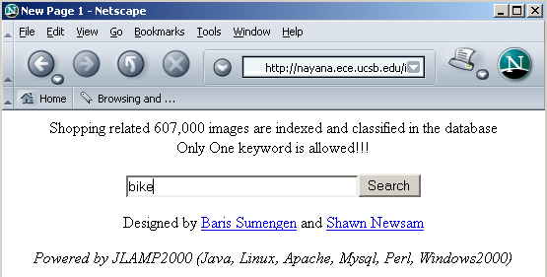
Relevance Feedback: Example
Sec. 9.1.1
Image search engine http://nayana.ece.ucsb.edu/imsearch/imsearch.html

Slide 12
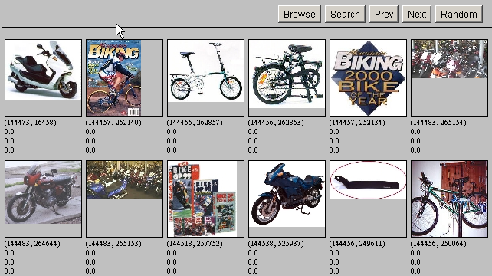
Results for Initial Query
Sec. 9.1.1

Slide 13
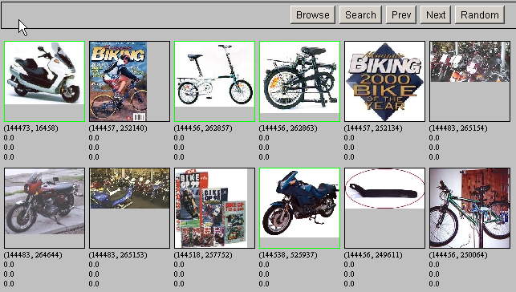
Relevance Feedback
Sec. 9.1.1

Slide 14
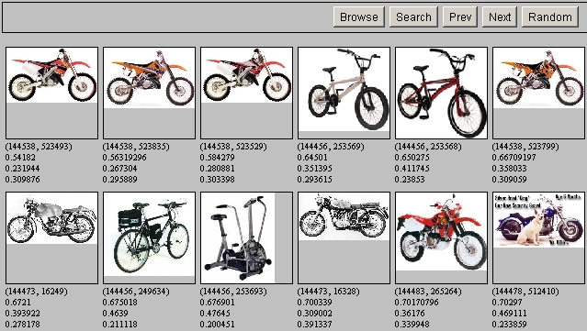
Results after Relevance Feedback
Sec. 9.1.1

Slide 15
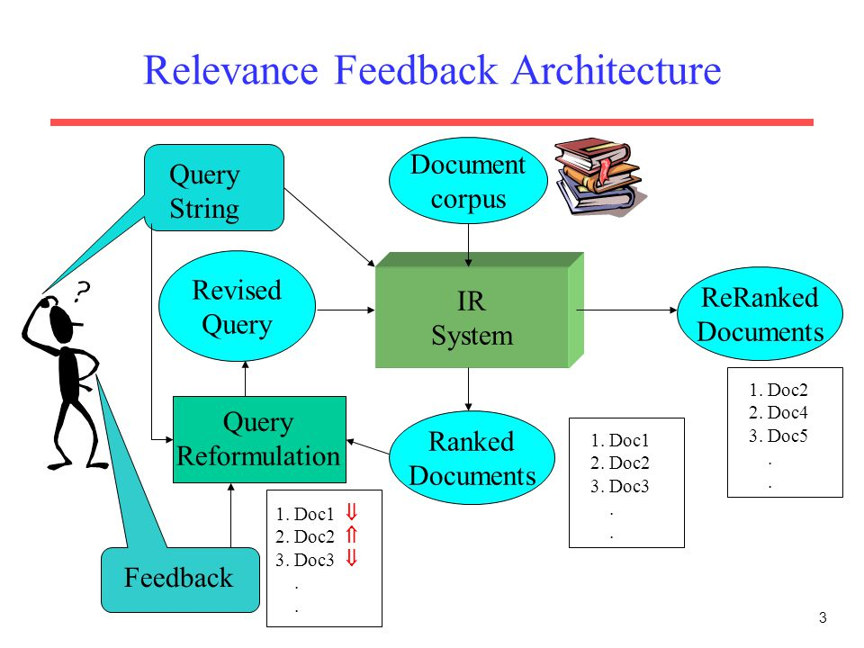

Slide 16
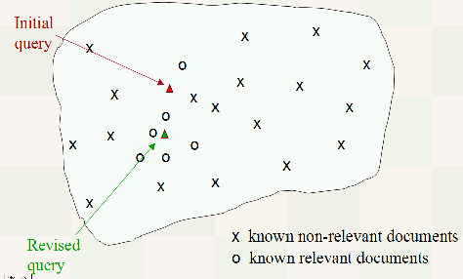

Slide 17
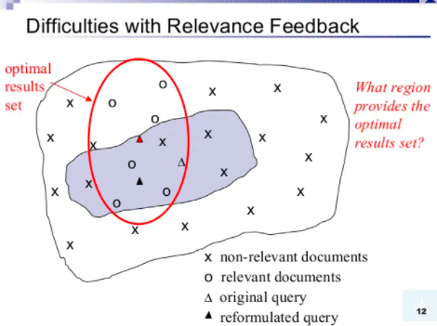

Slide 18
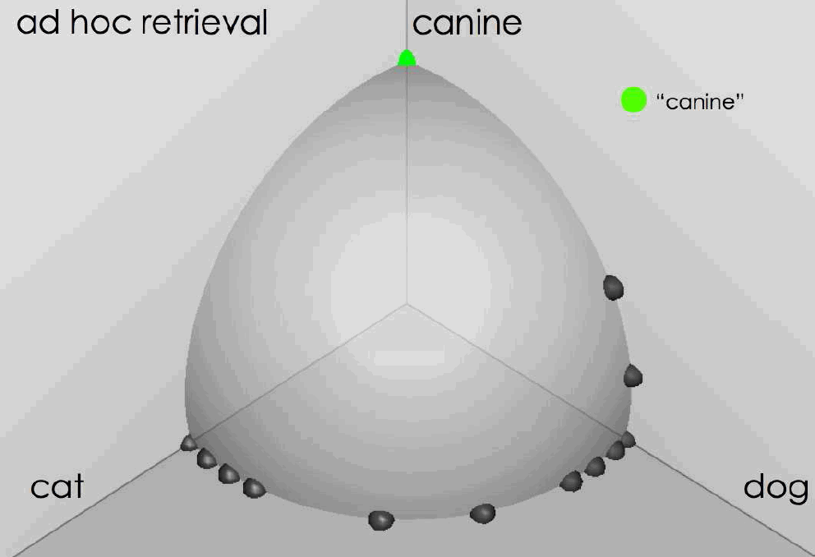
Ad hoc results for query canine source: Fernando Diaz

Slide 19
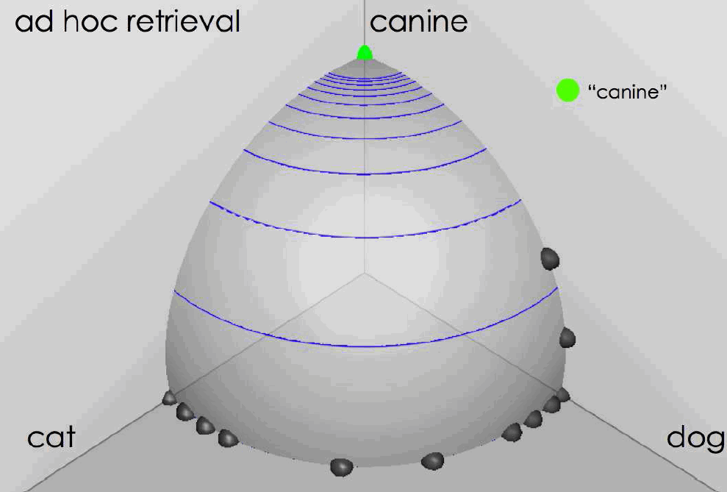
Ad hoc results for query canine
source: Fernando Diaz

Slide 20
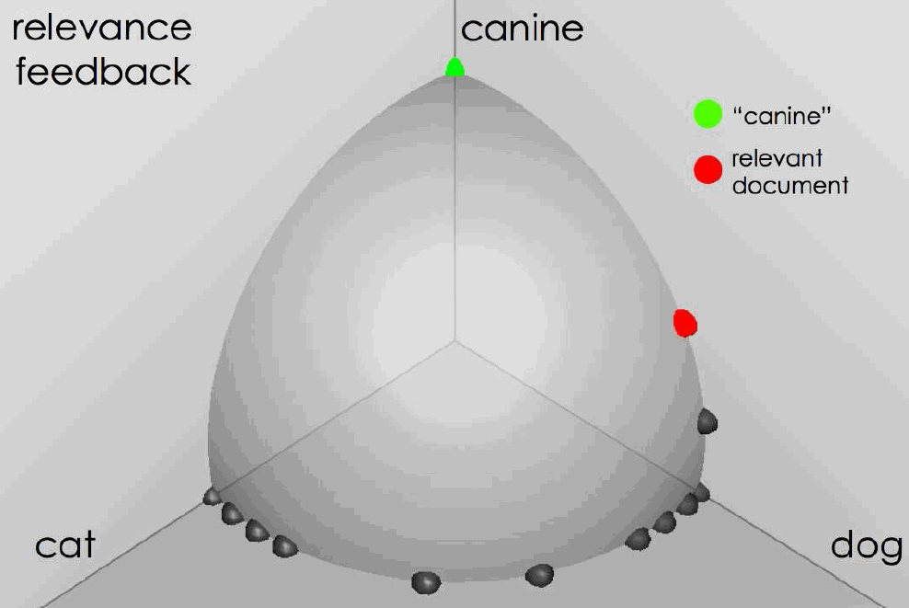
User feedback: Select what is relevant source: Fernando Diaz

Slide 21
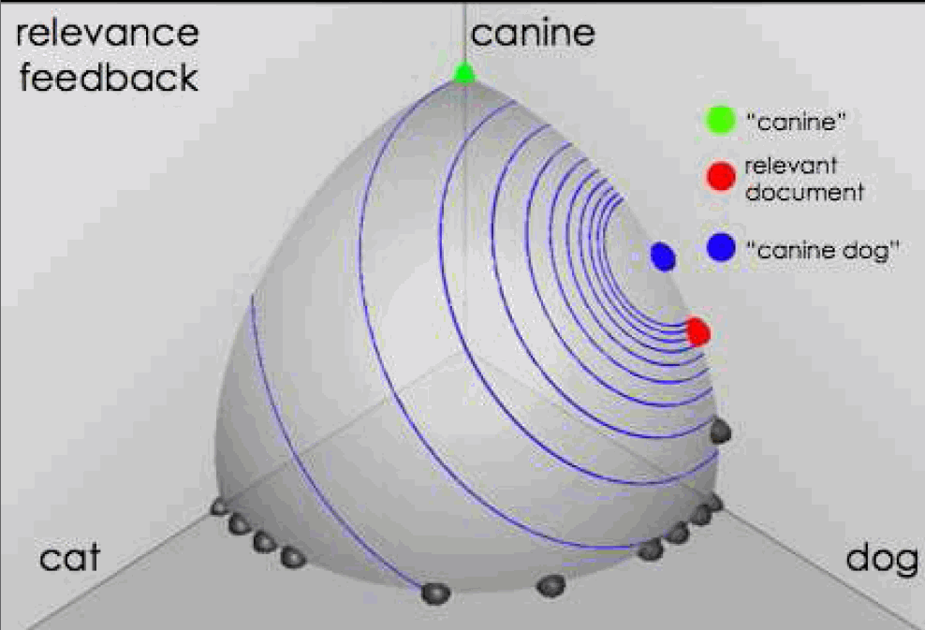
Results after relevance feedback source: Fernando Diaz

Slide 22
Initial query/results
Sec. 9.1.1
Initial query: New space satellite applications
  1. 0.539, 08/13/91, NASA Hasn’t Scrapped Imaging Spectrometer
  2. 0.533, 07/09/91, NASA Scratches Environment Gear From Satellite Plan
  3. 0.528, 04/04/90, Science Panel Backs NASA Satellite Plan, But Urges Launches of Smaller Probes
  4. 0.526, 09/09/91, A NASA Satellite Project Accomplishes Incredible Feat: Staying Within Budget
  5. 0.525, 07/24/90, Scientist Who Exposed Global Warming Proposes Satellites for Climate Research
  6. 0.524, 08/22/90, Report Provides Support for the Critics Of Using Big Satellites to Study Climate
  7. 0.516, 04/13/87, Arianespace Receives Satellite Launch Pact From Telesat Canada
  8. 0.509, 12/02/87, Telecommunications Tale of Two Companies
User then marks relevant documents with “+”.
+
+
+

Slide 23
Expanded query after relevance feedback
Sec. 9.1.1
2.074 new 15.106 space
30.816 satellite 5.660 application
5.991 nasa 5.196 eos
4.196 launch 3.972 aster
3.516 instrument 3.446 arianespace
3.004 bundespost 2.806 ss
2.790 rocket 2.053 scientist
2.003 broadcast 1.172 earth
0.836 oil 0.646 measure

Slide 24
Results for expanded query
Sec. 9.1.1
2
1. 0.513, 07/09/91, NASA Scratches Environment Gear From Satellite Plan
2. 0.500, 08/13/91, NASA Hasn’t Scrapped Imaging Spectrometer
3. 0.493, 08/07/89, When the Pentagon Launches a Secret Satellite, Space Sleuths Do Some Spy Work of Their Own
4. 0.493, 07/31/89, NASA Uses ‘Warm’ Superconductors For Fast Circuit
5. 0.492, 12/02/87, Telecommunications Tale of Two Companies
6. 0.491, 07/09/91, Soviets May Adapt Parts of SS-20 Missile For Commercial Use
7. 0.490, 07/12/88, Gaping Gap: Pentagon Lags in Race To Match the Soviets In Rocket Launchers
8. 0.490, 06/14/90, Rescue of Satellite By Space Agency To Cost $90 Million
1
8

Slide 25
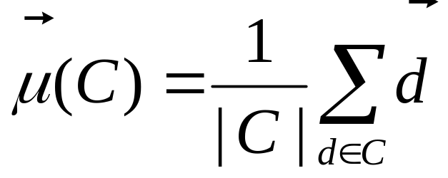
Key concept: Centroid
Sec. 9.1.1
The centroid is the center of mass of a set of points
Recall that we represent documents as points in a high-dimensional space
Definition: Centroid
where C is a set of documents.

Slide 26
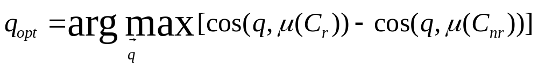
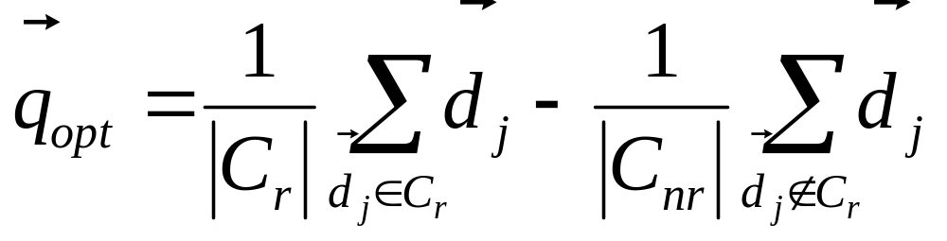
Rocchio Algorithm
Sec. 9.1.1
The Rocchio algorithm uses the vector space model to pick a relevance feedback query
Rocchio seeks the query q_{opt} that maximizes
Tries to separate docs marked relevant and non-relevant
Problem: we don’t know the truly relevant docs

Slide 27
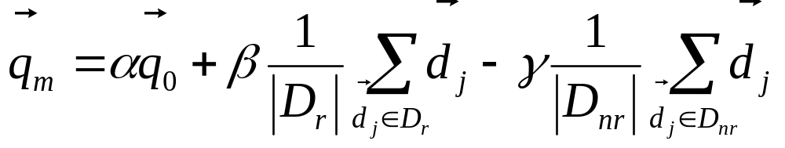
Rocchio 1971 Algorithm (SMART)
Sec. 9.1.1
Used in practice:
D_{r} = set of known relevant doc vectors
D_{nr} = set of known irrelevant doc vectors
  Different from C_{r} and C_{nr}
q_{m} = modified query vector; q₀ = original query vector; α,β,γ: weights (hand-chosen or set empirically)
New query moves toward relevant documents and away from irrelevant documents
!
Notes:
SMART: Cornell (Salton) IR system of 1970s to 1990s.

Slide 28
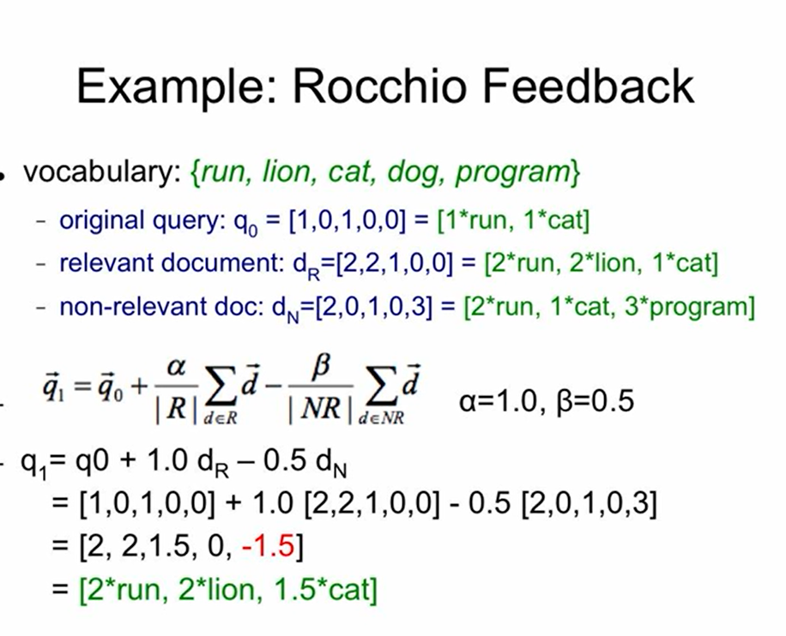
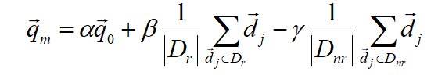


Slide 29
Relevance feedback on initial query
Sec. 9.1.1
Initial query
x
x
x
o
x
x
x
x
Δ
x
x
x
o
x
o
x
Δ
x
o
x
o
o
x
x
x
x
x known non-relevant documents
o known relevant documents
Revised query

Slide 30
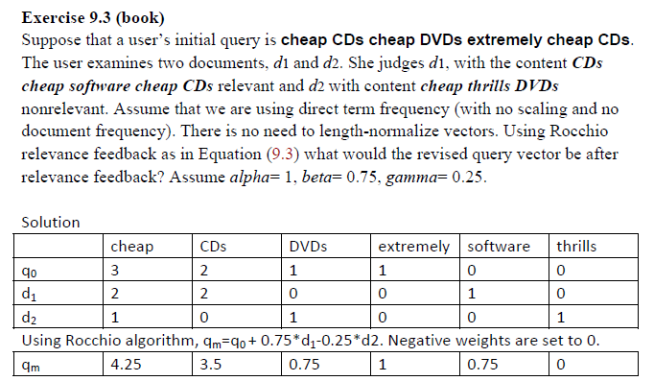

Slide 31
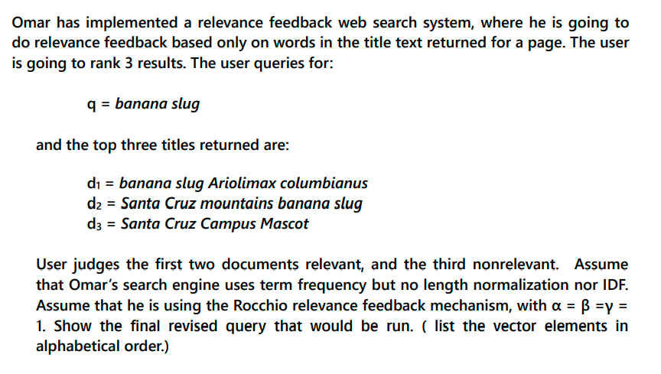

Slide 32
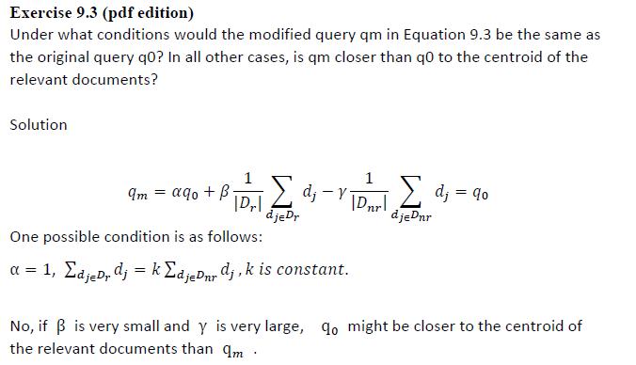

Slide 33
Relevance Feedback in vector spaces
Sec. 9.1.1
We can modify the query based on relevance feedback and apply standard vector space model.
Use only the docs that were marked.
Relevance feedback can improve recall and precision
Relevance feedback is most useful for increasing recall in situations where recall is important
  Users can be expected to review results and to take time to iterate
Notes:
Just as we modified the query in the vector space model, we can also modify it here. I’m not aware of work that uses language model based Ir this way.

Slide 34
Positive vs Negative Feedback
Sec. 9.1.1
Positive feedback is more valuable than negative feedback (so, set γ < β; e.g. γ = 0.25, β = 0.75).
Many systems only allow positive feedback (γ=0).
Why?
Notes:
It’s harder for user to give negative feedback (absence of evidence is not evidence of absence). It’s also harder to use since relevant documents can often form tight cluster, but non-relevant documents rarely do.

Slide 35
Aside: Vector Space can be Counterintuitive.
Doc
“J. Snow
& Cholera”
x
x
x
x
x
x
o
x
x
x
x
x
x
x
q1
x
x
x
x
x
x
x
x
x
q1 query “cholera”
o www.ph.ucla.edu/epi/snow.html
x other documents
Query
“cholera”
Notes:
Snow document puts a lot of weird historical stuff into the vectory

Slide 36
High-dimensional Vector Spaces
The queries “cholera” and “john snow” are far from each other in vector space.
How can the document “John Snow and Cholera” be close to both of them?
Our intuitions for 2- and 3-dimensional space don't work in >10,000 dimensions.
3 dimensions: If a document is close to many queries, then some of these queries must be close to each other.
Doesn't hold for a high-dimensional space.
Notes:
Q = query, Cr = relevant documents Cnr = not relevant documents

Slide 37
Relevance Feedback: Assumptions
Sec. 9.1.3
A1: User has sufficient knowledge for initial query.
A2: Relevance prototypes are “well-behaved”.
  Term distribution in relevant documents will be similar
  Term distribution in non-relevant documents will be different from those in relevant documents
    Either: All relevant documents are tightly clustered around a single prototype.
    Or: There are different prototypes, but they have significant vocabulary overlap.
    Similarities between relevant and irrelevant documents are small

Slide 38
Violation of A1
Sec. 9.1.3
User does not have sufficient initial knowledge.
Examples:
  Misspellings (Brittany Speers).
  Cross-language information retrieval (hígado).
  Mismatch of searcher’s vocabulary vs. collection vocabulary
    Cosmonaut/astronaut

Slide 39
Violation of A2
Sec. 9.1.3
There are several relevance prototypes.
Examples:
  Burma/Myanmar
  Contradictory government policies
  Pop stars that worked at Burger King
Often: instances of a general concept
Good editorial content can address problem
  Report on contradictory government policies

Slide 40
Relevance Feedback: Problems
Long queries are inefficient for typical IR engine.
  Long response times for user.
  High cost for retrieval system.
  Partial solution:
    Only reweight certain prominent terms
      Perhaps top 20 by term frequency
Users are often reluctant to provide explicit feedback
It’s often harder to understand why a particular document was retrieved after applying relevance feedback
Why?
Notes:
A long vector space query is like a disjunction: you have to consider documents with any of the words, and sum partial cosine similarities over the various terms.

Slide 41
Evaluation of relevance feedback strategies
Sec. 9.1.5
Use q₀ and compute precision and recall graph
Use q_{m} and compute precision recall graph
  Assess on all documents in the collection
      Spectacular improvements, but … it’s cheating!
      Partly due to known relevant documents ranked higher
      Must evaluate with respect to documents not seen by user
  Use documents in residual collection (set of documents minus those assessed relevant)
      Measures usually then lower than for original query
      But a more realistic evaluation
      Relative performance can be validly compared
Empirically, one round of relevance feedback is often very useful. Two rounds is sometimes marginally useful.
Notes:
It’s lower because the results aren’t on the documents that came in top on the original query, which are the ones most likely to be relevant.

Slide 42
Evaluation of relevance feedback
Sec. 9.1.5
Second method – assess only the docs not rated by the user in the first round
  Could make relevance feedback look worse than it really is
  Can still assess relative performance of algorithms
Most satisfactory – use two collections each with their own relevance assessments
  q₀ and user feedback from first collection
  q_{m} run on second collection and measured

Slide 43
Relevance Feedback on the Web
Sec. 9.1.4
Some search engines offer a similar/related pages feature (this is a trivial form of relevance feedback)
  Google (link-based)
  Altavista
  Stanford WebBase
But some don’t because it’s hard to explain to average user:
  Alltheweb
  bing
  Yahoo
Excite initially had true relevance feedback, but abandoned it due to lack of use.
α/β/γ ??

Slide 44
Excite Relevance Feedback
Sec. 9.1.4
Spink et al. 2000
Only about 4% of query sessions from a user used relevance feedback option
  Expressed as “More like this” link next to each result
But about 70% of users only looked at first page of results and didn’t pursue things further
  So 4% is about 1/8 of people extending search
Relevance feedback improved results about 2/3 of the time

Slide 45
Pseudo relevance feedback
Sec. 9.1.6
Pseudo-relevance feedback automates the “manual” part of true relevance feedback.
Pseudo-relevance algorithm:
  Retrieve a ranked list of hits for the user’s query
  Assume that the top k documents are relevant.
  Do relevance feedback (e.g., Rocchio)
Works very well on average
But can go horribly wrong for some queries.
Several iterations can cause query drift.
Why?

Slide 46
FEEDBACK - IR EVALUATION

Slide 47
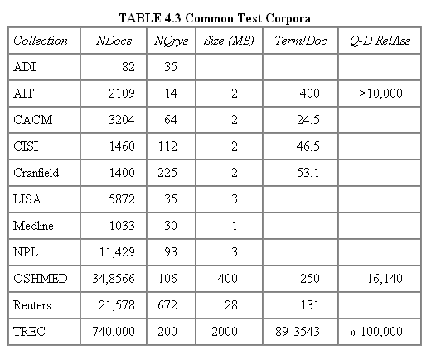
Test Collections
Assessing Relevance

Slide 48
Unit of Evaluation
Assessing Relevance
We can compute precision, recall, F, and MAP for different units.
Possible units
  Documents (most common)
  Facts (used in some TREC evaluations)
  Entities (e.g., car companies)
May produce different results. Why?

Slide 49
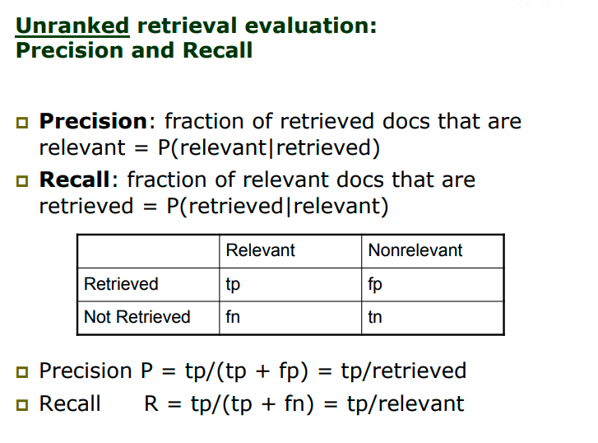

Slide 50
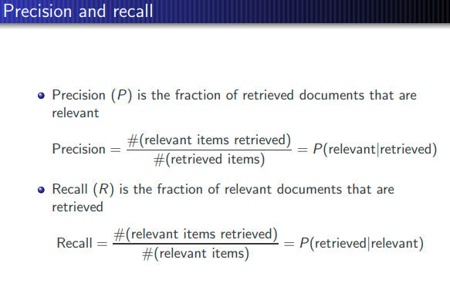

Slide 51
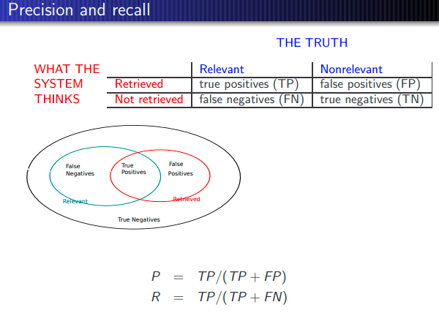

Slide 52
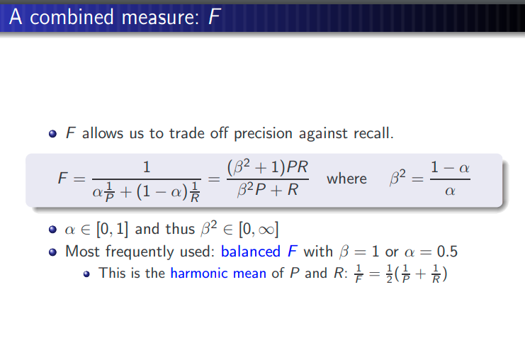

Slide 53
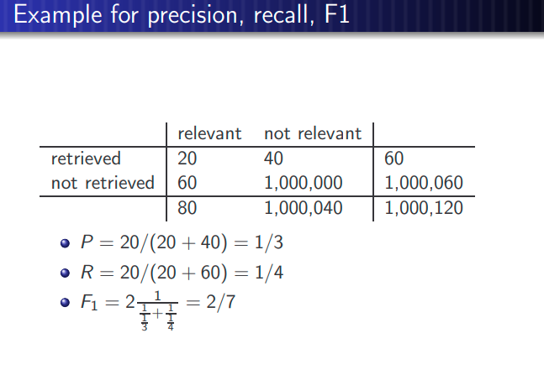

Slide 54
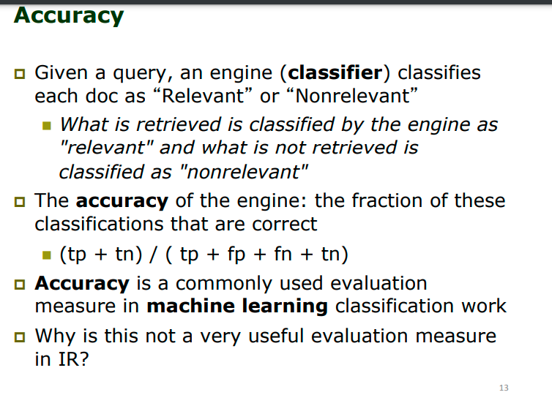

Slide 55
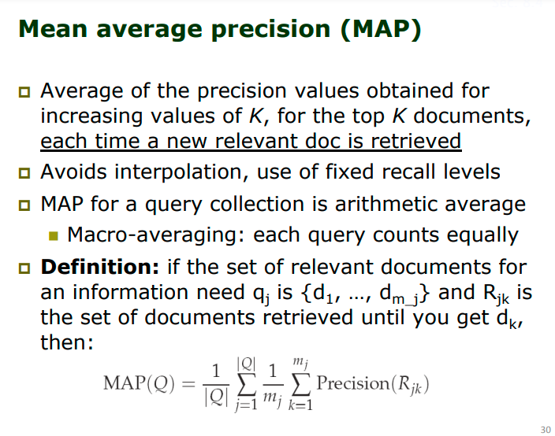

Slide 56
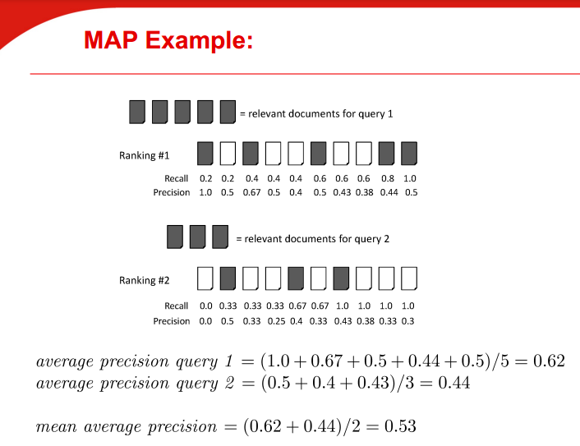

Slide 57
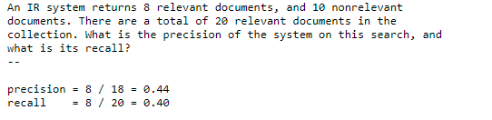
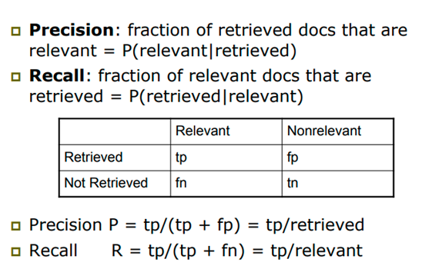

Slide 58
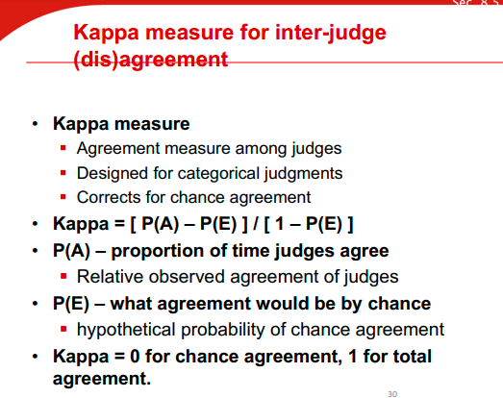

Slide 59
Kappa Measure: Example
Assessing Relevance
P(A)? P(E)?
Number of docs | Judge 1 | Judge 2
300 | Relevant | Relevant
70 | Nonrelevant | Nonrelevant
20 | Relevant | Nonrelevant
10 | Nonrelevant | Relevant

Slide 60
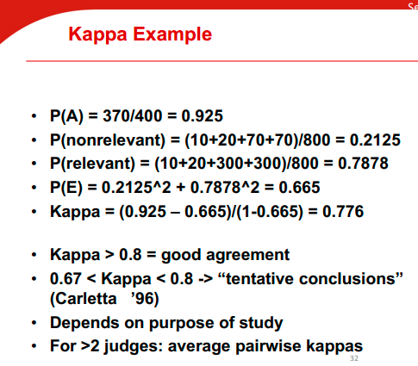

Slide 61
Kappa measure for inter-judge (dis)agreement
Assessing Relevance
Kappa measure
  Agreement measure among judges
  Designed for categorical judgments
  Corrects for chance agreement
Kappa = [ P(A) – P(E) ] / [ 1 – P(E) ]
P(A) – proportion of the times the judges agree
P(E) – what agreement would be by chance
Kappa = 0 for chance agreement, 1 for total agreement.

Slide 62
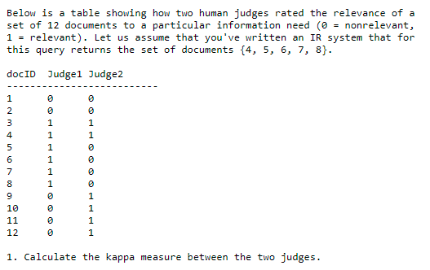
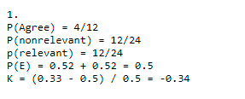

Slide 63
Kappa Example
Assessing Relevance
P(A) = 370/400 = 0.925
P(nonrelevant) = (10+20+70+70)/800 = 0.2125
P(relevant) = (10+20+300+300)/800 = 0.7878
P(E) = 0.2125^2 + 0.7878^2 = 0.665
Kappa = (0.925 – 0.665)/(1-0.665) = 0.776
Kappa > 0.8 = good agreement
0.67 < Kappa < 0.8 -> “tentative conclusions” (Carletta ’96)
Depends on purpose of study
For >2 judges: average pairwise kappas

Slide 64
Query Expansion

Slide 65
Query Expansion
Sec. 9.2.2
In relevance feedback, users give additional input (relevant/non-relevant) on documents, which is used to reweight terms in the documents
In query expansion, users give additional input (good/bad search term) on words or phrases

Slide 66

Query assist
Would you expect such a feature to increase the query
volume at a search engine?

Slide 67
How do we augment the user query?
Sec. 9.2.2
Manual thesaurus
  E.g. MedLine: physician, syn: doc, doctor, MD, medico
  Can be query rather than just synonyms
Global Analysis: (static; of all documents in collection)
  Automatically derived thesaurus
    (co-occurrence statistics)
  Refinements based on query log mining
    Common on the web
Local Analysis: (dynamic)
  Analysis of documents in result set

Slide 68
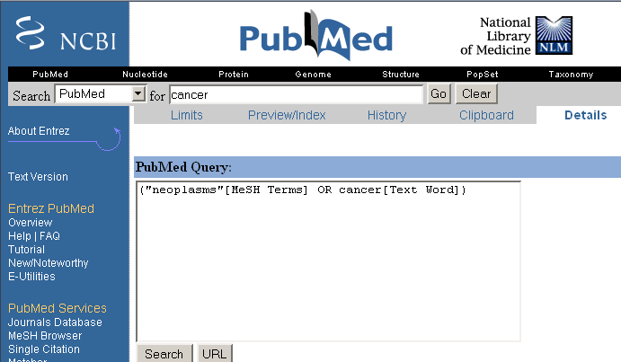
Example of manual thesaurus
Sec. 9.2.2

Slide 69
Thesaurus-based query expansion
Sec. 9.2.2
For each term, t, in a query, expand the query with synonyms and related words of t from the thesaurus
  feline → feline cat
May weight added terms less than original query terms.
Generally increases recall
Widely used in many science/engineering fields
May significantly decrease precision, particularly with ambiguous terms.
  “interest rate” → “interest rate fascinate evaluate”
There is a high cost of manually producing a thesaurus
  And for updating it for scientific changes

Slide 70
Automatic Thesaurus Generation
Sec. 9.2.3
Attempt to generate a thesaurus automatically by analyzing the collection of documents
Fundamental notion: similarity between two words
Definition 1: Two words are similar if they co-occur with similar words.
Definition 2: Two words are similar if they occur in a given grammatical relation with the same words.
You can harvest, peel, eat, prepare, etc. apples and pears, so apples and pears must be similar.
Co-occurrence based is more robust, grammatical relations are more accurate.
Why?

Slide 71
Co-occurrence Thesaurus
Sec. 9.2.3
Simplest way to compute one is based on term-term similarities in C = AA^{T} where A is term-document matrix.
w_{i,j} = (normalized) weight for (t_{i} ,d_{j})
For each t_{i}, pick terms with high values in C
d_{j}
N
t_{i}
What does C contain if A is a term-doc incidence (0/1) matrix?
M

Slide 72
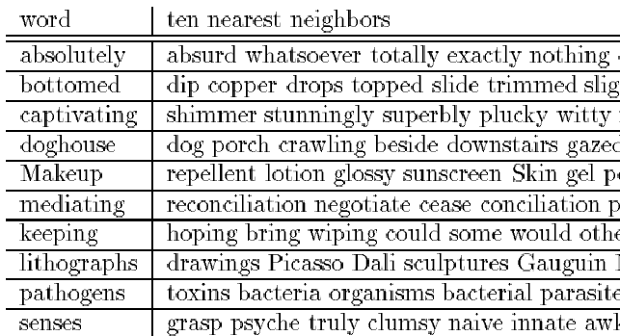
Automatic Thesaurus Generation
Example
Sec. 9.2.3

Slide 73
Automatic Thesaurus Generation
Discussion
Sec. 9.2.3
Quality of associations is usually a problem.
Term ambiguity may introduce irrelevant statistically correlated terms.
  “Apple computer” → “Apple red fruit computer”
Problems:
  False positives: Words deemed similar that are not
  False negatives: Words deemed dissimilar that are similar
Since terms are highly correlated anyway, expansion may not retrieve many additional documents.

Slide 74
Indirect relevance feedback
On the web, DirectHit introduced a form of indirect relevance feedback.
DirectHit ranked documents higher that users look at more often.
  Clicked on links are assumed likely to be relevant
    Assuming the displayed summaries are good, etc.
Globally: Not necessarily user or query specific.
  This is the general area of clickstream mining
Today – handled as part of machine-learned ranking
Notes:
Link analysis is kind of similar too.

Slide 75
Problems with Global Analysis
Term ambiguity may introduce irrelevant statistically correlated terms.
  “Apple computer” → “Apple red fruit computer”
Since terms are highly correlated anyway, expansion may not retrieve many additional documents.

Slide 76
Automatic Local Analysis
At query time, dynamically determine similar terms based on analysis of top-ranked retrieved documents.
Base correlation analysis on only the “local” set of retrieved documents for a specific query.
Avoids ambiguity by determining similar (correlated) terms only within relevant documents.
  “Apple computer” → “Apple computer Macbook laptop”

Slide 77
Global vs. Local Analysis
Global analysis requires intensive term correlation computation only once at system development time.
Local analysis requires intensive term correlation computation for every query at run time (although number of terms and documents is less than in global analysis).
But local analysis gives better results.

Slide 78
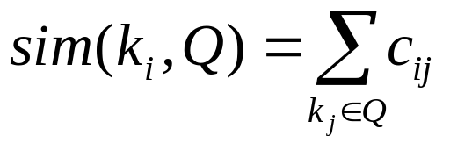
Global Analysis Refinements
Only expand query with terms that are similar to all terms in the query.
  “fruit” not added to “Apple computer” since it is far from “computer.”
  “fruit” added to “apple pie” since “fruit” close to both “apple” and “pie.”
Use more sophisticated term weights (instead of just frequency) when computing term correlations.

Slide 79
Query Expansion Conclusions
Expansion of queries with related terms can improve performance, particularly recall.
However, must select similar terms very carefully to avoid problems, such as loss of precision.

Slide 80
Problems with Global Analysis
Term ambiguity may introduce irrelevant statistically correlated terms.
  “Apple computer” → “Apple red fruit computer”
Since terms are highly correlated anyway, expansion may not retrieve many additional documents.

Slide 81
Automatic Local Analysis
At query time, dynamically determine similar terms based on analysis of top-ranked retrieved documents.
Base correlation analysis on only the “local” set of retrieved documents for a specific query.
Avoids ambiguity by determining similar (correlated) terms only within relevant documents.
  “Apple computer” → “Apple computer Macbook laptop”

Slide 82
Global vs. Local Analysis
Global analysis requires intensive term correlation computation only once at system development time.
Local analysis requires intensive term correlation computation for every query at run time (although number of terms and documents is less than in global analysis).
But local analysis gives better results.

Slide 83
Global Analysis Refinements
Only expand query with terms that are similar to all terms in the query.
  “fruit” not added to “Apple computer” since it is far from “computer.”
  “fruit” added to “apple pie” since “fruit” close to both “apple” and “pie.”
Use more sophisticated term weights (instead of just frequency) when computing term correlations.

Slide 84
Query Expansion Conclusions
Expansion of queries with related terms can improve performance, particularly recall.
However, must select similar terms very carefully to avoid problems, such as loss of precision.

Slide 85
Resources
IIR Ch 9
MG Ch. 4.7
MIR Ch. 5.2 – 5.4

